Slide 1
COST OF PRODUCTION
Samir K Mahajan, M.Sc, Ph.D.,UGC-NET

Slide 2

COST FUNCTION
Economists have treated cost as a function of output both in short run and long run.
SHORT RUN COST FUNCTION
In the short run, capital, land, factors prices, technology etc remain fixed. Hence, short run cost function can be written as
C$=f(Q, \overline{K}$ $\overline{\text{P}\text{f}}$, $\overline{T}$, …)
where
C is cost of production
Q is Output (total output)
$\overline{K}$, are capital and other fixed factor
$\overline{\text{P}\text{f}}$ is factor prices
$\overline{T}$ is given technology
Thus short run cost function can be written as
C=f (Q)

Slide 3
COST FUNCTION(contd)
LONG RUN COST FUNCTION
The long run cost function can be written as
C=C (Q, K, T ,P_{f} )
Where C is cost of production
Q is output
T is technology
K is capital
P_{f} is factor prices
In studying the relationship between long run cost and level of output in a two dimensional diagram, we keep technology and output as constant.
Thus , long run cost function, traditionally, is written as
C= C (Q)

Slide 4
CONCEPT OF COSTS(SHORT RUN)
Total Fixed Cost (TFC):
Total Fixed Cost (TFC)/ Fixed Costs are the expenses on fixed factors of production. Fixed cost do not vary with output. They remain the same what ever be the output in short run.
They typically include rents, salaries of permanent employees, insurance, depreciation etc.
Total variable cost (TVC)
Total variable cost (TVC) /Variable costs are expenses on variable factors of production. Variable costs do vary with output. As output changes, TVC also changes.
Examples of typical variable costs include fuel, raw materials, and casual labour costs.
Total Cost:
Total cost is the sum of fixed and variable costs at each level o output.
i.e. TC=TFC+ TVC

Slide 5
CONCEPT OF COSTS(contd)
TFC, TVC, TC curves
TC
TVC
Cost
Fixed Cost
Variable Cost
Total
Cost
TFC
O
Output

Slide 6
CONCEPT OF COSTS(contd)
Average Fixed Cost (AFC) : Average fixed cost is the fixed cost per unit of output.
TFC
i.e. AFC=
Q
Where Q is output.

Slide 7
CONCEPT OF COSTS(contd)
Average Variable Cost (AVC) : Average variable cost is the variable cost per unit of output.
TVC
i.e. AVC=
Q
Where Q is output.

Slide 8
CONCEPT OF COSTS(contd)
Average Cost (AC) : Average cost is the cost per unit of output.
TC
i.e. AC=
Q
TFC+ TVC
=
Q
Or, AC= AFC + AVC
Where Q is output.

Slide 9
CONCEPT OF COSTS(contd)
Marginal cost (MC) : Marginal cost is the extra cost for producing an additional unit of output.
d(TC)
i.e. MC=
dQ
d(TFC + TVC)
MC=
dQ
d(TVC)
MC=
dQ
It is important to note that marginal cost is derived solely from variable costs, and not from fixed costs.

Slide 10
CONCEPT OF COSTS(contd)
AFC, AC, AVC, MC curves
Cost
MC
AC
AVC
AFC
O
Output

Slide 11
RELATIONSHIP BETWEEN AC AND MC
Minimum MC comes before, Minimum AC.
When AC falls, MC < AC
When AC increases, MC > AC
When AC is at its minimum, MC equals AC. i.e. MC=Minimum AC.

Slide 12
CONCEPT OF COSTS(contd)
AVERAGE FIXED COST (AFC) FALLS WITH INCREASE IN OUTPUT
AFC curve is downward sloping from left to right.
REASONS
As total fixed cost is divided by an increasing output, AFC will continue to fall. AFC may be very close to zero, but will never be equal to zero.

Slide 13
CONCEPT OF COSTS(contd)
AVERAGE VARIABLE COST CURVE , AVERAGE COST CURVE , AVERAGE COST CURVE are IS U-SHAPED
With the increase in output each of these curves will slope down at frist from left to right, then reach a minimum point, and rise again.
‘U’ shaped AVC , MC, AC curve can be attributed to the principle of variable proportion.

Slide 14
LONG RUN AVERAGE COST FUNCTION
Or
LONG RUN AVERAGE COST (LAC) CURVE
The long run cost function/LAC curve depicts the least possible average cost for producing various levels of output when inputs of production are variable (in the long run).
The LAC is constructed from a series of short run average cost curves associated with a series of different output levels. In short run, capital (say plant) is fixed, and labour is variable. As such, each of the short run average cost (SAC) curves corresponds to a particular plant. When a new plant is installed, the SAC curve shifts to a new location.
The LAC curve is the envelope of an infinite number of SAC curves, with each SAC curve tangent to the LAC curve at a single point corresponding to a particular output level.

Slide 15
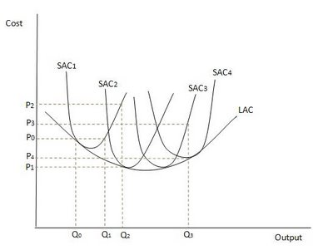
LONG RUN AVERAGE COST FUNCTION (contd)
Let us consider the short run curves given by SAC1, SAC2, SAC3 and SAC4 as in the following figure.
To produce Q0, the firm will use SAC1 curve where cost is P0. To produce a higher level of output at Q1, the firm will again use SAC1 curve at which the cost remain the same at P0.

Slide 16
LONG RUN AVERAGE COST FUNCTION (contd)
To produce Q2, if the firm continues to use SAC1 curve, then the cost will increase to P2(P2>PO). So, it would be better for the firm to bring a second plant into the production with cost curve SAC2. Here, cost of producing Q2 would be P1, much less than P2.
Similarly, to Produce Q3, the firm can either use SAC3 or SAC4 curve. If it uses SAC3 curve, the cost of production would be P3 which is higher than P4 at SAC4. Hence, the firm will use SAC4 curve, as it has low cost(P4).

Slide 17
LONG RUN AVERAGE COST FUNCTION (contd)
The above description confirms that, in long run, a firm will use the level of inputs that can produce a given level of output at the lowest possible average cost. The envelope relationship explains that at the planned output level, SAC equals LAC; but at all other levels of output, SAC is higher than LAC. This is reflected in LAC curve which is always be less than or equal to short-run average cost.

Slide 18
Revenue
Samir K Mahajan, M.Sc, Ph.D.,UGC-NET

Slide 19
Revenue
Meaning :
Revenue is the receipt of money from the sale of output by a firm in a given time period.
Concepts of Revenue
Total Revenue
Average revenue
Marginal Revenue

Slide 20
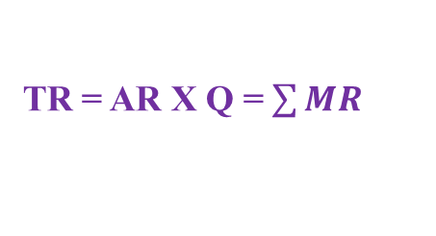
Total Revenue
Total Revenue (TR) is the total amount of money receipts of a firm from the sale of output.
TR = Price X Q where Q is the output sold
TR = AR X Q = $\sum{MR}$

Slide 21


Average Revenue
Average Revenue (AR) is revenue per unit of output sold.
AR=Price

Slide 22

Marginal Revenue
Marginal Revenue (MR) is the rate of change in total revenue with respect to change in output.
Where,
Q is output sold

Slide 23
TR, AR and MR under Im-Perfect Competition
Revenue
When total Revenue is maximised, MR = 0
AR curve is the demand curve facing a firm in the market
AR and MR curves are downward sloping, MR curve lies below AR curve.
TR
0
Output Sold
Revenue
MR
AR
0
Output Sold

Slide 24
TR, AR and MR under Perfect Competition
Revenue
TR
Under perfect Competition price is uniform and given. As such, AR(price) and MR become equal.
AR and MR curves coincide and become parallel to output axis.
3. AR curve i.e. the demand curve facing a firm in the market is perfectly elastic.
0
Output Sold
Revenue
p
AR=MR=Price
0
Output Sold

Slide 25
PROFIT , BREAK-EVEN POINT
AND
EQUILIBRIUM OF A FIRM
Samir K Mahajan, M.Sc, Ph.D.,UGC-NET
Assistant Professor (Economics)
Department of Mathematics & Humanities
Institute of Technology
Nirma University

Slide 26
PROFIT
Profit is defined as the gap between total revenue and total cost.
Profit(∏ ) =Total Revenue – Total Cost
When profit is negative, a firm is said to be suffering from loss.
BREAK -EVEN POINT
Break-even point indicates the level of output at which Total Revenue just equals Total Cost .
EQUILIBRIUM OF A FIRM
A firm is said to in equilibrium when it maximises its profit at given level of output.
Thus, at firm’s equilibrium, profit(TR-TC) is maximum.

Slide 27
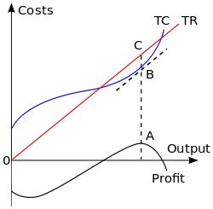
Break-Even Point and Firm’s Equilibrium(Maximum Profit)
Revenue/
D(TR=TC) is lower break-even point at output S.
E (TR=TC) is upper break even point
E
D
S
Q
To the left of lower break-even point D(output S), profit is negative.
When the firm increases its output beyond output S, the positive gap between TR and TC increase and profit accrue to the firm.

Slide 28
Break-Even Point and Firm’s Equilibrium(Maximum Profit) (contd.)
The firm is in equilibrium (maximum profit =CB=AQ) at Q level of output after which the gap between TR and TC goes on narrowing. TR again becomes equal to TC at upper break even point E.
Upper break-even E point is not of much relevance as it lies beyond firm's profit maximizing level. Further, it lies beyond the firm’s capacity.
The lower break even point D at output S is much significance as the firm would not plan to expand if it can not sell its output equal to at least S.

Slide 29
EQUILIBRIUM OF A FIRM /PROFIT MAXIMISATION BY A FIRM : MARGINAL APPROACH
EQUILIBRIUM OF A FIRM
A firm is said to in equilibrium when it maximises its profit at given level of output.
Thus, at firm’s equilibrium, profit(TR-TC) is maximum.
CONDITIONS FOR PROFIT MAXIMISATION/FIRM’S EQUILBRIUM:
MR=MC (Necessary Condition)
MC must be rising at the profit maximising/equilibrium point i.e MC curve must cut MR curve from bellow(Sufficient Condition)

Slide 30
Equilibrium of a firm /Profit Maximisation by a firm (Marginal Approach contd.) : Graphical Illustration contd.
Revenue/
Cost
MC
A
E ( Profit Maxising Point)
P
Output expansion
AR=MR=Price
0
Q
Output
Here at point A, MR=MC but MC cuts point A from above. Hence though necessary condition is satisfied , sufficient condition is not. Hence it is not profit maximising point.
Falling MC induces the firm to produce more and more till MC curve cuts MR curve from bellow.

Slide 31
Equilibrium of a firm /Profit Maximisation : Graphical Illustration (contd.)
At point E , MR=MC and MC curve cuts MR curve from bellow. At E, both necessary and sufficient conditions are satisfied. Hence E is the point of equilibrium at which the firm maximises its profit.
Q is the equilibrium or profit maximising output. The firm will not produce beyond point E or output Q . Because after point E, MR < MC. As a result of which the firm will suffer loss.

Slide 32

EQUILIBRIUM OF A FIRM /PROFIT MAXIMISATION : MATHEMATICAL FORMULATION (CONTD.)
Conditions for Profit Maximisation:
Necessary Condition:
Sufficient Condition:
We have,
Profit(∏ ) = TR - TC
Let TR =R(Q) and TC=C(Q)
where Q is output.

Slide 33

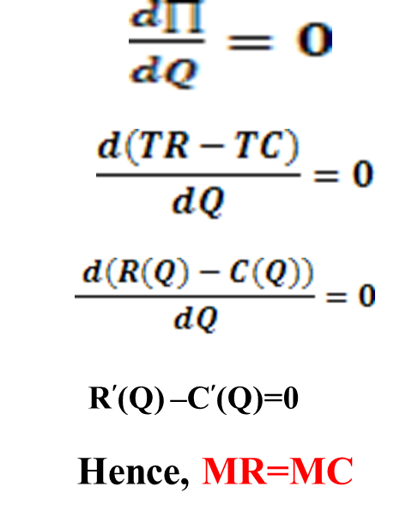
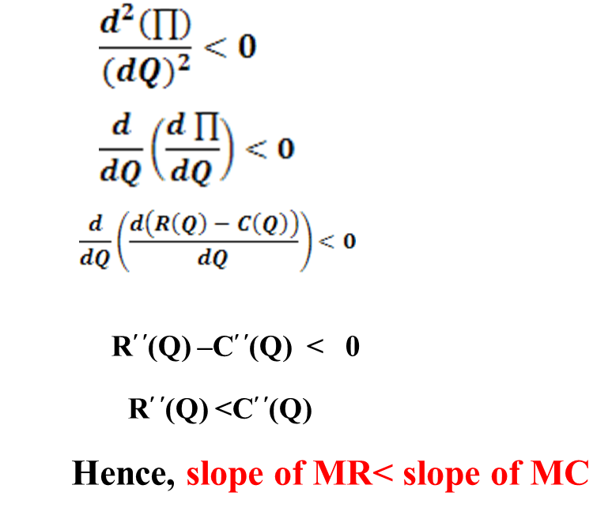
Equilibrium of a firm /Profit Maximisation : Mathematical Formulation (contd.)
Conditions for Profit Maximisation:
At maximum profit,
Necessary Condition

